Slide 1
Digital Electronics and Systems
Topic : Special purpose gates

Slide 2
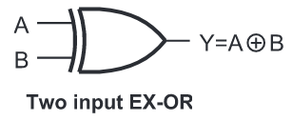

XOR gate
Exclusive OR gate ( EX-OR gate)
It is also known as inequality detector.
Logic Symbol

Slide 3
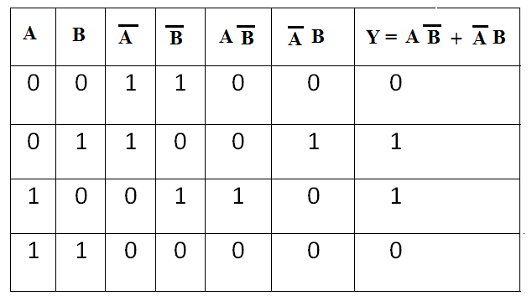
Truth Table

Slide 4
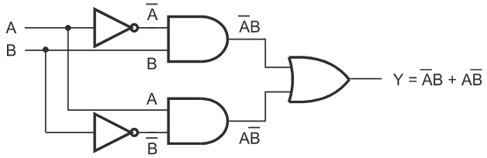
Logic diagram

Slide 5
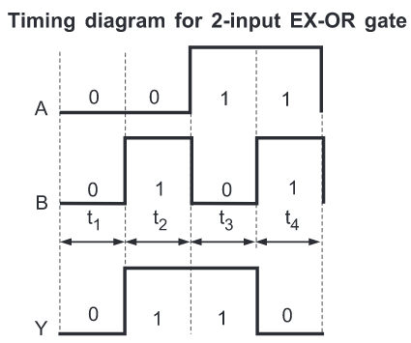

Slide 6
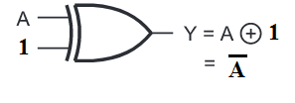
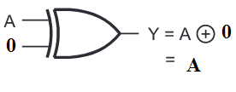

Slide 7



Slide 8


XNOR gate
Exclusive NOR gate ( EX-NOR gate)
It is also known as equality detector.
Logic Symbol

Slide 9
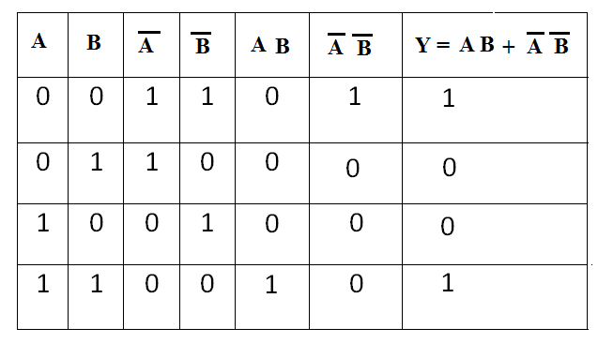
Truth Table

Slide 10
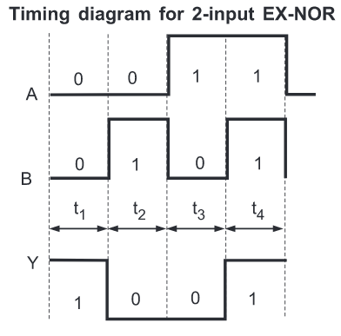

Slide 11
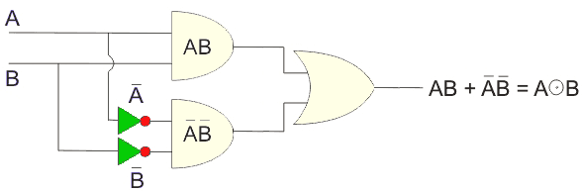
Logic diagram

Slide 12



Slide 13



